Slide 1


Intrusion Detection System using ML & DL
This project focuses on developing an Intrusion Detection System (IDS) using advanced Machine Learning (ML) and Deep Learning (DL) techniques. Our goal is to enhance network security by accurately detecting malicious network traffic.
01

Slide 2
Group Members
WAQAR UL HASSAN (231270)
QASIM AKBAR (231300)
M AZEEM KHAN (231294)
AHMED MUSTAFA (231304)
02

Slide 3
Problem Statement
Rapid growth of network-based attacks
Traditional security systems fail to detect new threats
Need for intelligent, adaptive intrusion detection
Accurate and real-time attack detection is critical
Manual monitoring is inefficient and error-prone
03

Slide 4





Intrusion Detection System (IDS)
Monitors network/system activities
Detects malicious or abnormal behavior
Generates alerts for security analysis
Used with SIEM systems
Enhances overall network security
04

Slide 5

Types of IDS
Host-Based IDS (HIDS):
Network-Based IDS (NIDS):
Monitors single host activities
Monitors entire network traffic
Analyzes logs, processes, system calls
Analyzes packets and flows
Detects network-level attacks
05

Slide 6


Detection Techniques
Signature-Based Detection
Anomaly-Based Detection
Matches known attack patterns
Learns normal behavior
Effective for known threats
Flags abnormal patterns
Cannot detect zero-day attacks
Detects unknown and emerging attacks
06

Slide 7

Dataset Description (NSL-KDD)
125,973
22,544
43
Training samples
Testing samples
Total features
2
Output classes
Normal / Attack
The NSL-KDD dataset is a benchmark for intrusion detection, featuring both numerical and categorical feature types.
07

Slide 8
Data Preprocessing
01
02
03
Feature scaling using RobustScaler
Categorical encoding using One-Hot Encoding
Binary label conversion (Normal = 0, Attack = 1)
04
05
Dimensionality reduction using PCA
Reduced features from 122 to 20
08

Slide 9
Machine Learning Models Used
Logistic Regression
K-Nearest Neighbors (KNN)
Naive Bayes
Support Vector Machine (SVM)
Decision Tree
Random Forest
XGBoost
Artificial Neural Network (ANN)
09

Slide 10
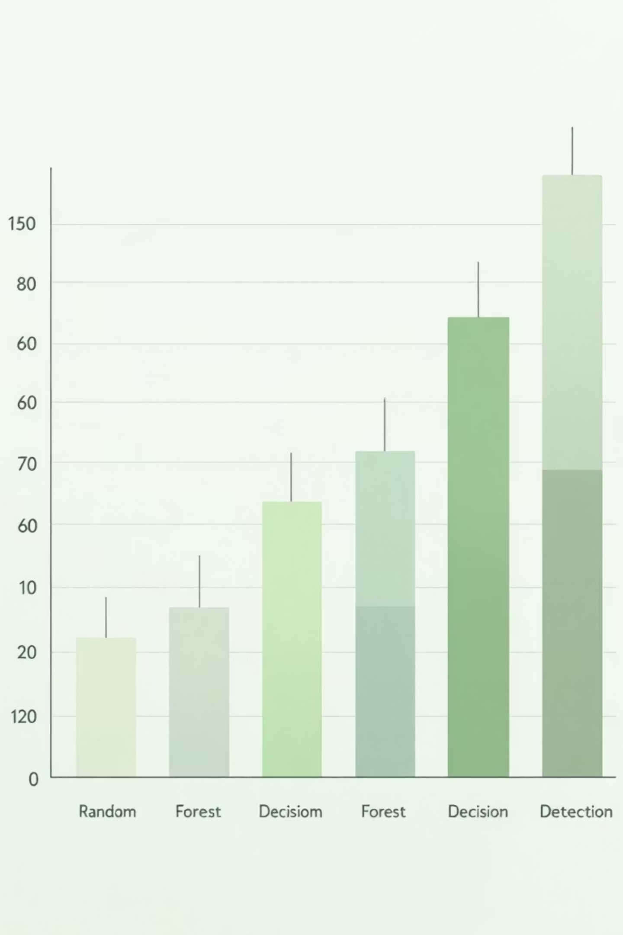
Slide 9 – Model Performance Summary
KNN: ~98.8% test accuracy
Decision Tree: ~99.8% test accuracy
Random Forest: ~99.88% test accuracy
SVM: ~96.8% test accuracy
ANN: High accuracy with deep learning
Evaluation metrics: Accuracy, Precision, Recall, Confusion Matrix
10

Slide 11
Key Outcomes & Conclusion
AI-based IDS effectively detects intrusions
Random Forest showed best overall performance
PCA reduced complexity with minimal accuracy loss
System successfully classifies normal vs attack traffic
AI improves accuracy, adaptability, and security
11

Slide 12
Thank You
12

